Slide 1
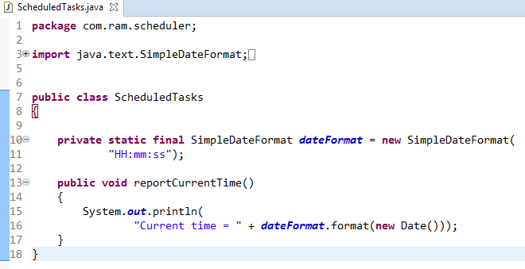
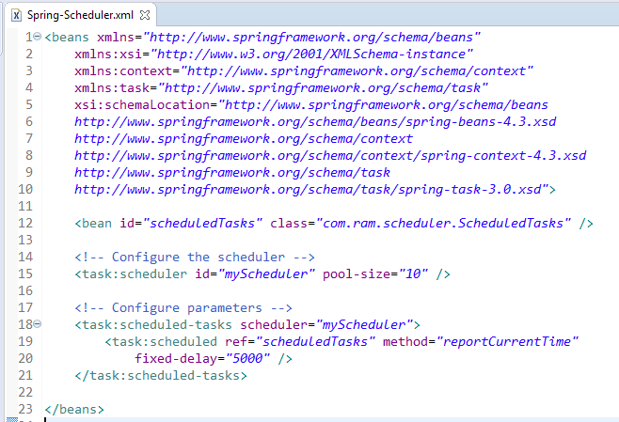
Schedule a Task at Fixed Delay [Configuring scheduled tasks using XML]
Here we have configured a task to run after a fixed delay.
In this case, the duration between the end of last execution and the start of next execution is fixed. The task always waits until the previous one is finished.
This option should be used when it’s mandatory that the previous execution is completed before running again.

Slide 2
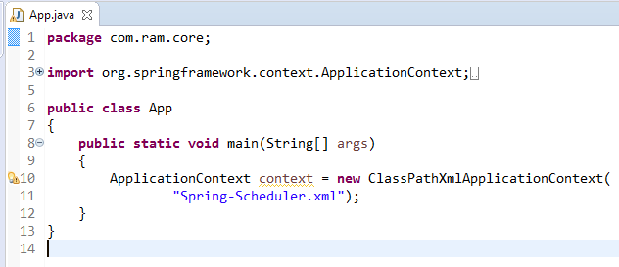
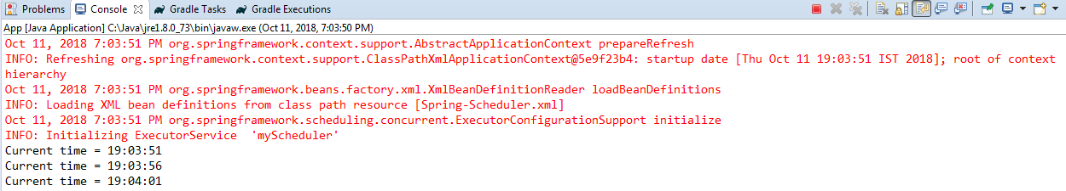
Schedule a Task at Fixed Delay [Configuring scheduled tasks using XML]

